Slide 1
CS371m - Mobile Computing
Nifty Stuff

Slide 2
We have touched on many of the basic features of the Android System and Apps
Activities, Services, Content Resolvers, Broadcast Receivers
Intents
Activity Lifecycle
UIs, widgets, ViewGroups, ActionBar
Location Manager
Sensor Manager
2D graphics
Persistence, Shared Preferences
Responsiveness
Gestures
SQLite
Fragments
Web APIs
Navigation Strategies

Slide 3
Surface Scratched
We have covered some of the basics
Numerous features and capabilities we haven't covered
Plus features added in every release
Example: KitKat release, October 2013
NFC via Host Card Emulation, printing framework, storage access framework, low power sensors, step detector, changes to SMS provider, full screen immersive mode, transition framework for animating scenes, Chromium WebView, screen recording, RenderScript Compute, IR Blaster, and more!
http://tinyurl.com/nmfaxwu
Lollipop: November 2014: http://tinyurl.com/prpuqgy
Marshmallow: October 2015: http://tinyurl.com/okd5oul

Slide 4
audio

Slide 5
Audio on Device
Devices have multiple audio streams:
music, alarms, notifications, incoming call ringer, in call volume, system sounds, DTMF tones (dual tone multi frequency, the "traditional" phone sounds and tones)
Most of the streams are restricted to system events, so we almost always use STREAM_MUSIC via a MediaPlayer or SoundPool

Slide 6
media player

Slide 7
Android Audio
Using the MediaPlayer class
Common Audio Formats supported:
MP3, MIDI (.mid and others), Vorbis (.ogg), WAVE (.wav) and others
Sources of audio
local resources (part of app)
internal URIs (Content Provider for other audio available)
External URLs (streaming)

Slide 8
Audio Resources
res/raw directory
assets/ directory
reference as file://andorid_asset in a URI
can share with other apps via URI
Store media in application local directory, pull from network / web and store locally
Store and use media on SD card
Stream via the Internet

Slide 9
MediaPlayer
Playback control of MediaPlayer managed as a state machine
Idle
Initialized
Preparing
Prepared
Started
Paused
Playback Complete
Stopped
End
Invalid state transitions result in errors

Slide 10
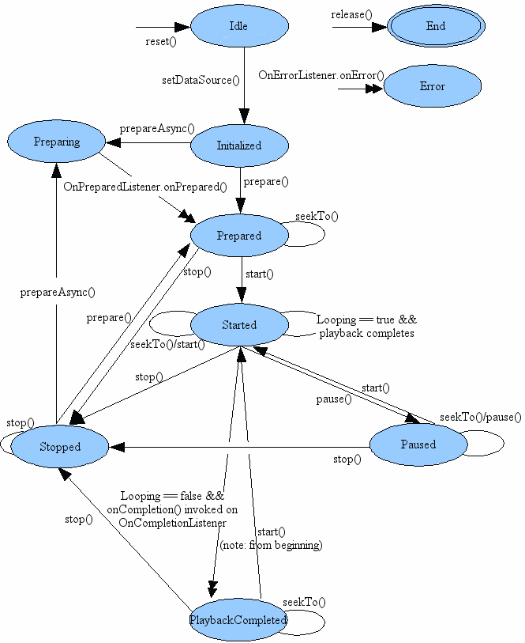
MediaPlayer State Diagram
Single arrows are synchronous transitions
Double arrows are asynchronous transitions

Slide 11
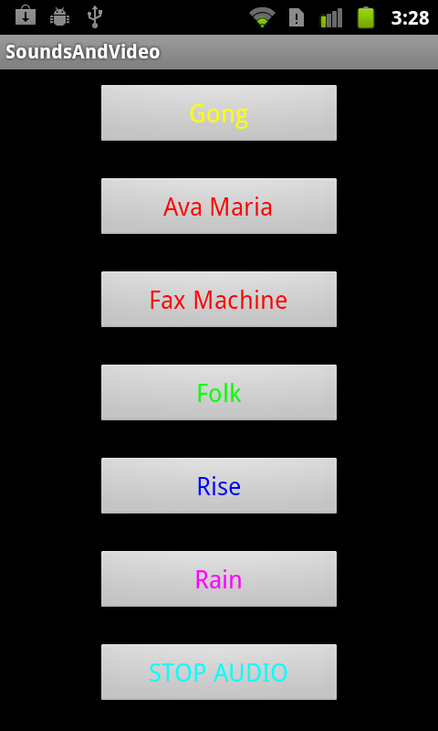
Simple Sound Demo App
audio files local to app placed in res/raw
CAUTION
large sound files difficult to install on emulator:
http://tinyurl.com/3pwljfj
better success with dev phones / actual devices

Slide 12
Using MediaPlayer
MediaPlayer.create() method used for raw resources
MediaPlayer.create() method for URIs
various MediaPlayer.setDataSource() methods if not a raw resource and not a URI

Slide 13
Playing Local Audio
To play audio local to the app
use the MediaPlayer.create convenience method
when complete MediaPlayer in the prepared state
start MediaPlayer
approach:
build listeners for each button to call the playSound method with appropriate song id when clicked

Slide 14
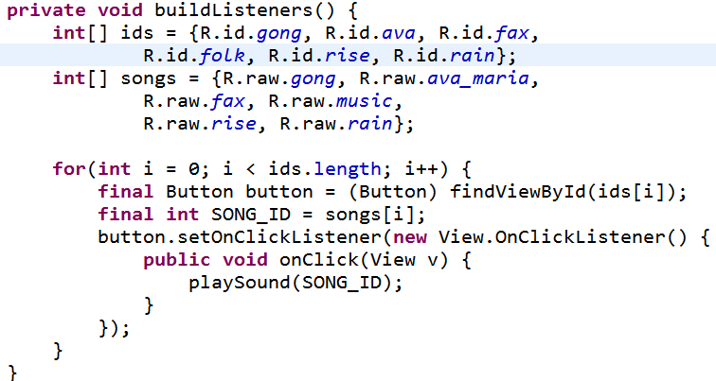
Simple Approach
button ids
ids for sound files

Slide 15
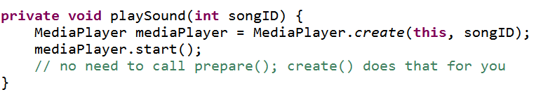
playSound method initial version
downsides of first version of app
plays to completion
multiple sounds play at same time (desirable in some cases), code creates multiple media players
audio continues to play when app paused

Slide 16
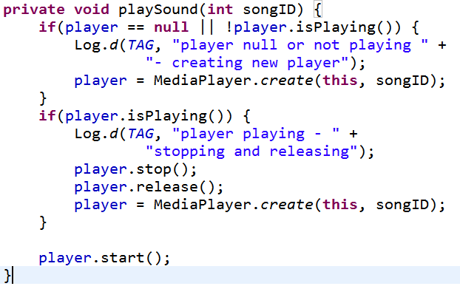
Changing Behavior
Add instance variable for MediaPlayer
If playing stop and release before creating new Player

Slide 17
Cleaning Up
Initial version did not end well
Audio continued to play if back button pressed and even if home button pressed!
Activity Life Cycle
in onPause for app we should stop MediaPlayer and release

Slide 18
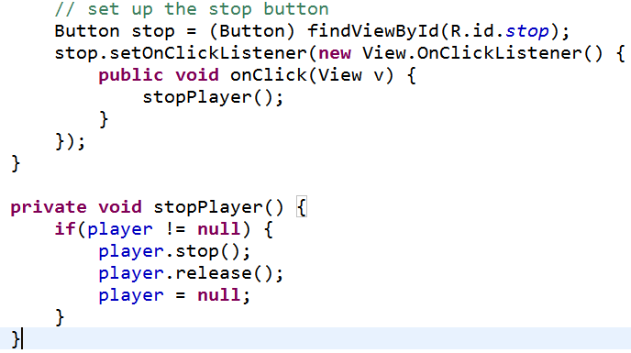
stopPlayer method
Connect app stop button to stopPlayer
could use XML onClick and add View parameter or set up listener ourselves
in buildListeners method

Slide 19
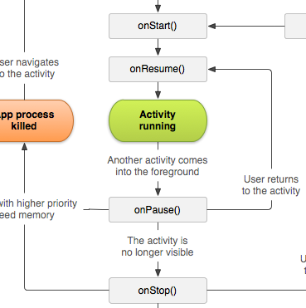
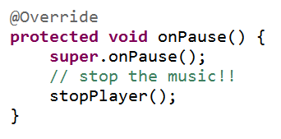
onPause
onPause() should call the stopPlayer method
what happens if activity resumed?

Slide 20
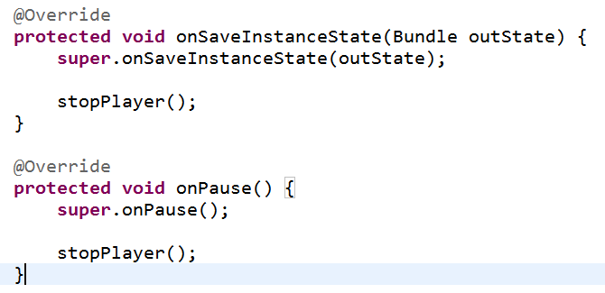
Saving State
Resume music where we left off if paused or activity destroyed due to orientation change

Slide 21
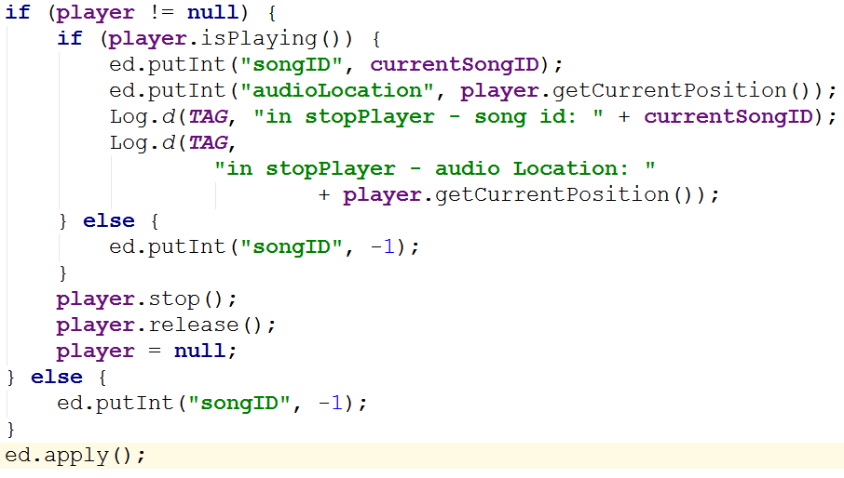
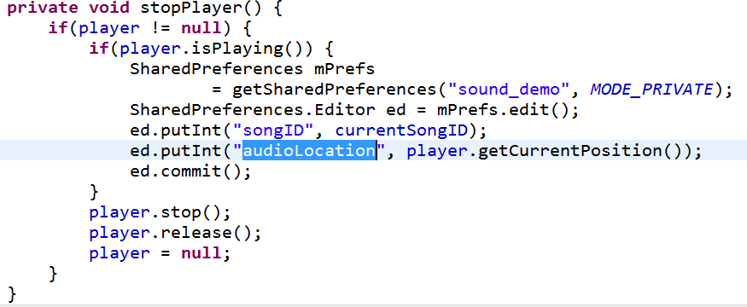
Saving MediaPlayer State
Not a lot of data so used the SharedPreferences
Save location in shared preferences

Slide 22
Restarting Audio
In onResume check if audio was interrupted recreate player with same id and move to correct position
Can write data to shared preferences or bundle (onSaveInstanceState) and pull out in onResume

Slide 23
haptic feedback

Slide 24
Haptic Feedback
haptic: "of or relating to the sense of touch"
Simple to add this kind of feedback to an app
can enable haptic feedback for any view
Can add complex haptic feedback of our own

Slide 25
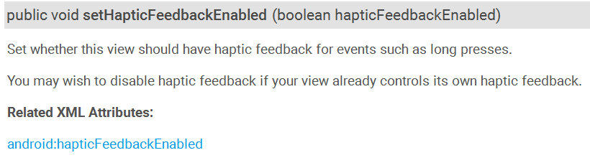
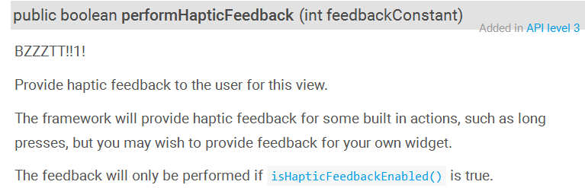
Haptic Feedback on a View
Methods from View class

Slide 26
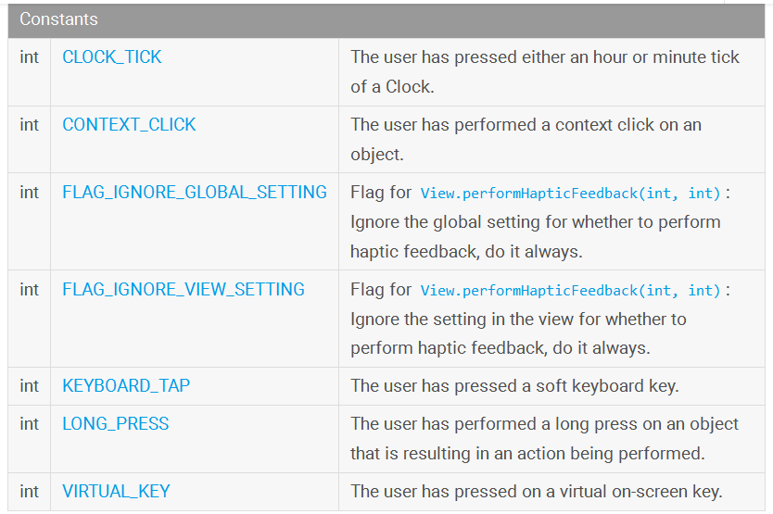
HapticFeedbackConstants Class

Slide 27
More Complex Feedback
Also possible to create more complex haptic feedback for apps:
Request permission
Get the Vibrator object from the system
call vibrate method

Slide 28
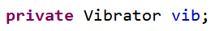
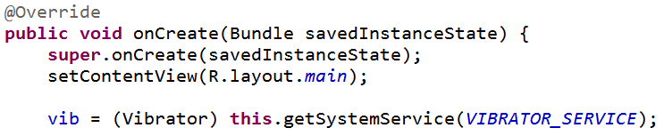
Haptic Feedback
Request Permission
Get Vibrator

Slide 29
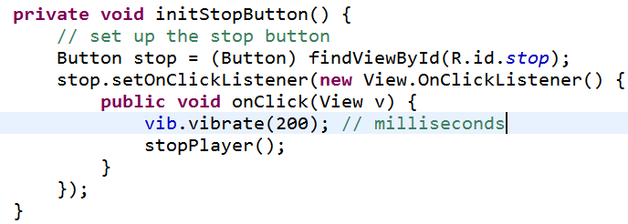
Haptic Feedback
Create feedback

Slide 30
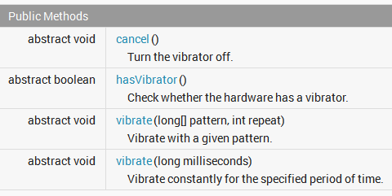
Vibrator Methods

Slide 31
recording audio

Slide 32
Simple and Complex
Simple:
There may already been an app to record sound on the device.
Create an Intent and call startActivityForResult
MediaStore.Audio.Media.RECORD_SOUND_ACTION
Complex: read on

Slide 33
Recording Audio - MediaRecorder
create MediaRecorder object
set audio source
set audio format
set file format for audio
set file name to record to
prepare MediaRecorder for recording
start recording
stop and release MediaRecorder

Slide 34
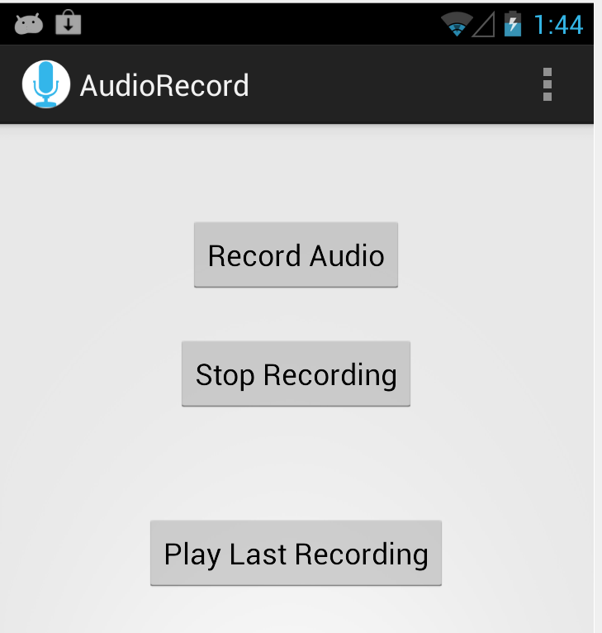
Record Audio
Simple View with buttons to start and stop recording
alternatively could change text on record audio button
single button or toggle switch

Slide 35
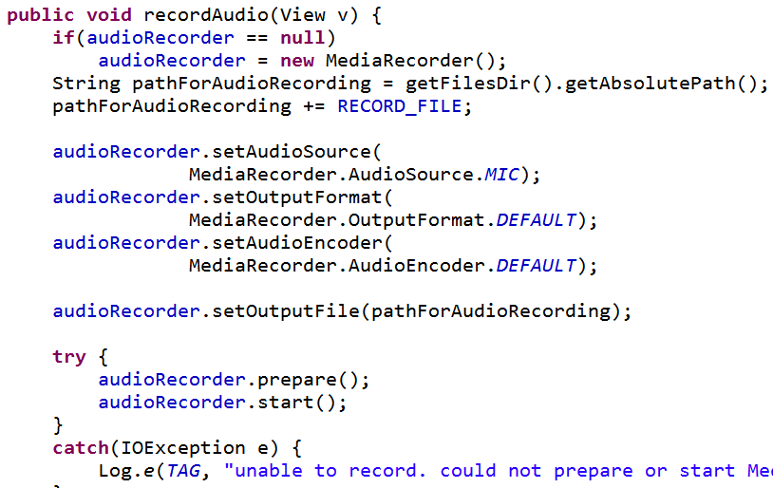
Record Audio

Slide 36
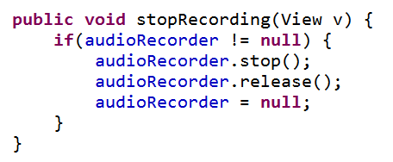
Stop Recording
a few seconds of audio results in a file size of ~ 10 kb with default settings
PERMISSIONS! -- must request RECORD_AUDIO and WRITE_EXTERNAL_STORAGE permissions in manifest file

Slide 37
speech recognition

Slide 38
Speech Recognition
android.speech package
Simplest example - start an Intent for a result
RecognizerIntent.ACTION_RECOGNIZE_SPEECH
uses network
works on the dev phones
doesn't work on emulator

Slide 39
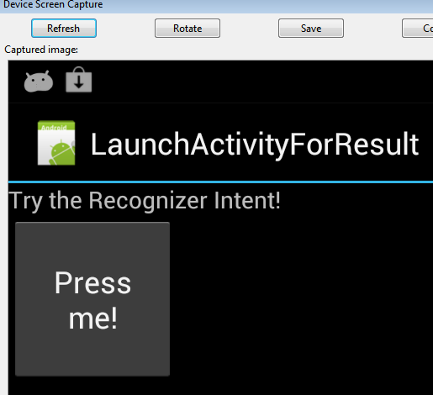
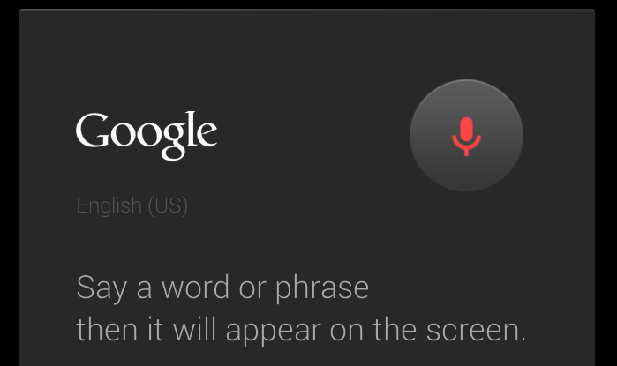
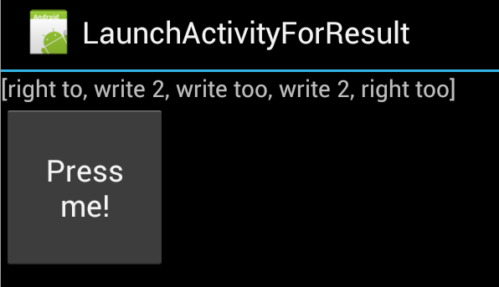
Speech Recognition

Slide 40
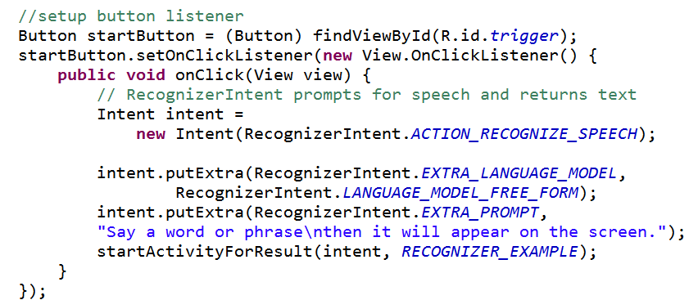
Starting Intent

Slide 41
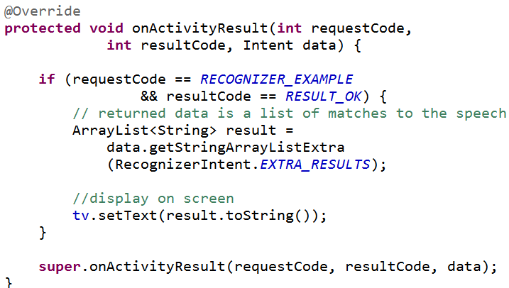
Responding to Result
Note: list of results, ordered by confidence

Slide 42
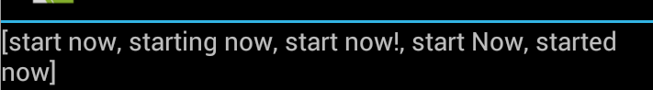
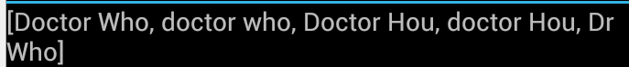

Results

Slide 43
Activity Recognition

Slide 44
Activity Recognition
Google service to try and determine user's current activity:
Standing Still
walking / on foot
bicycle
in vehicle
unknown

Slide 45
Activity Recognition
Uses recognition client
Related but separate from location client
Request frequency of updates
Get list of updates and confidence level of activity

Slide 46
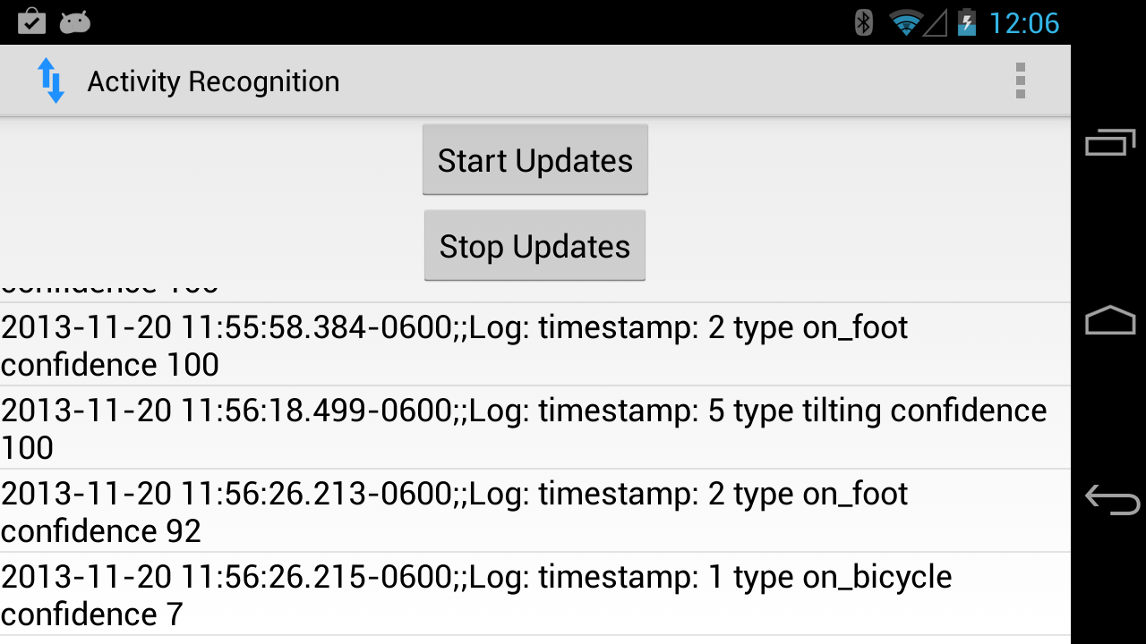
Sample App

Slide 47
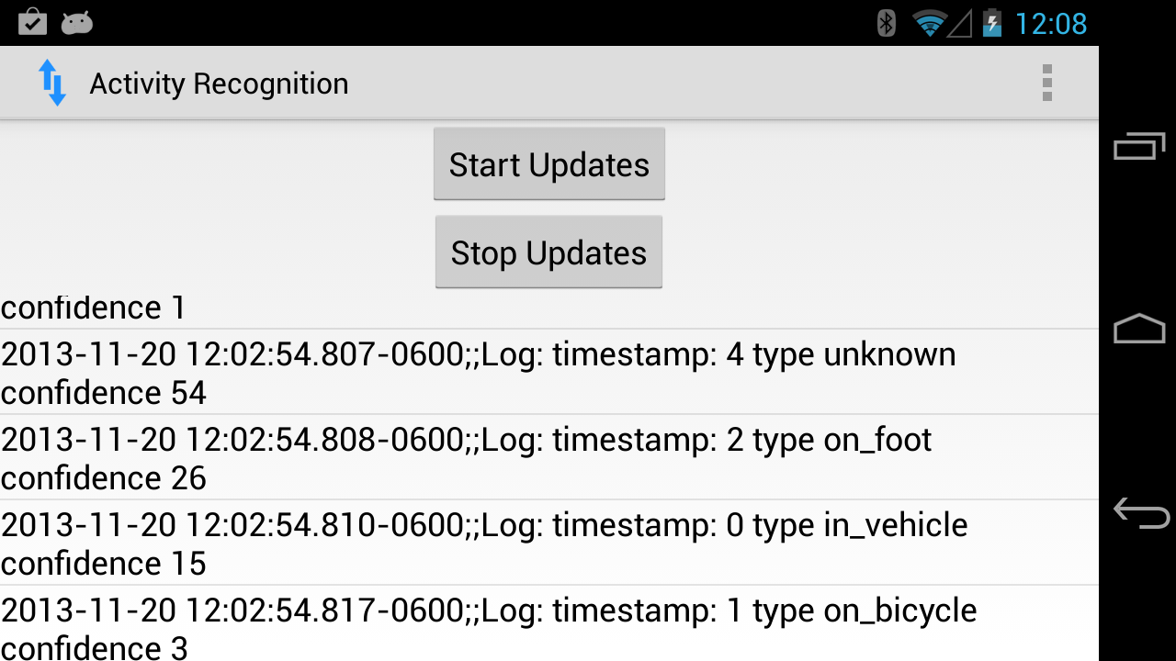
Sample App

Slide 48
Recognition Activity
Special Permission
Uses the Google Play services APK
must ensure this is available on device

Slide 49
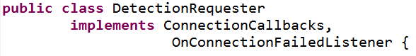
Recognition Activity
Request updates on activities
… and implement appropriate call back methods

Slide 50
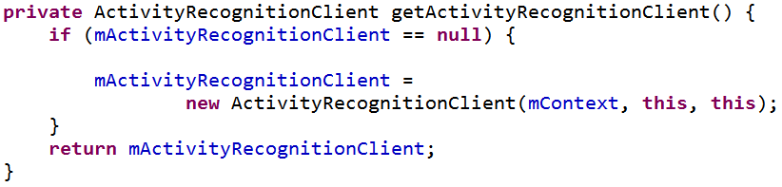
Get ActivityRecognitionClient
Create a PendingIntent - an Intent that will be handled at a later time

Slide 51
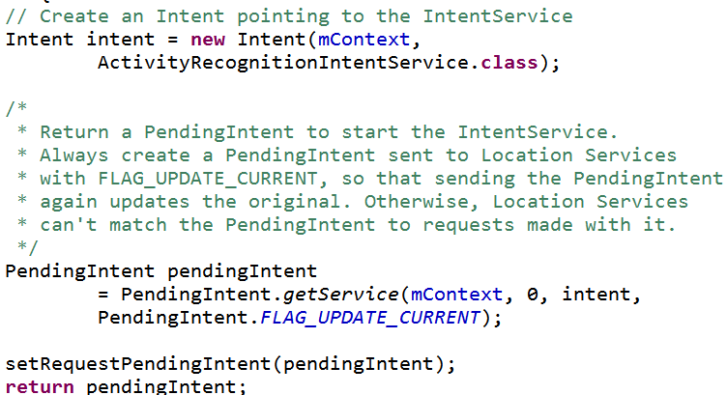
PendingIntent For ActvityRecognition
service to
receive updates

Slide 52
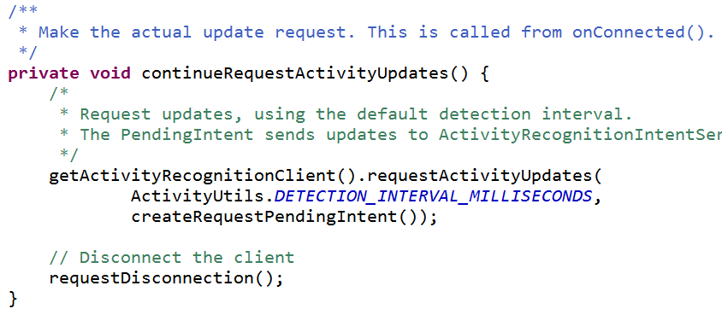
Request Activity Updates
Using the Pending Intent

Slide 53
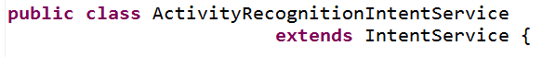
Getting Data Back
The ActivityRecognition Service will send Intents with updates
Create a subclass of IntentService to deal with these

Slide 54
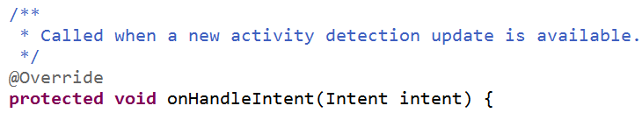
IntentService
Implement the onHandleIntent method to deal with incoming intents from ActivityRecognition
Formats data from Intent, logs to shared preferences, notifies user if changed

Slide 55
Notifications

Slide 56
Notification
Message to user from app OUTSIDE of the app's normal UI
Appears first in Notification Area
formerly status bar notifications
User looks at details of Notification in the Notification Drawer
The Notification Area and Notification Drawer are both controlled by the system

Slide 57
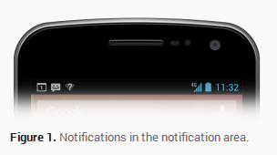
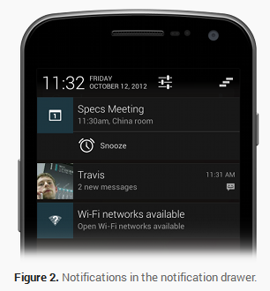
http://developer.android.com/guide/topics/ui/notifiers/notifications.html

Slide 58
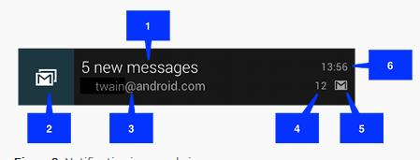
Notification Style - Normal
In the drawer Notifications Normal View or Big View
Normal View
content title
large icon
content text
content info
small icon
time issued

Slide 59
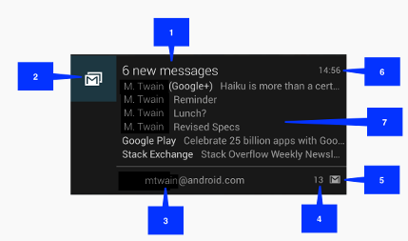
Notification Style - Big
Adds 7 -> details area

Slide 60
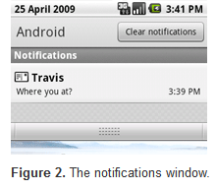
Notifications
Advice for Notifications
use for time sensitive events
… that involve other people
don't create notifications for events not directed at user
don't create notification for Activity that is active

Slide 61
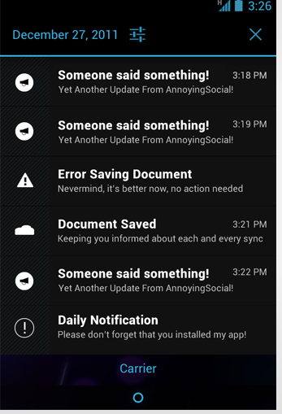
Notifications Window
Bad Notifications
Don't create notifications for low level technical details
Don't create notifications for errors that user can't fix or if app can recover on its own
Don't create notifications for services user can't start and stop
P

Slide 62
Notifications DOs
Make it personal
if notification caused by action of a contact, include contact image or icon
Navigate to correct place
may take user to deep in app, update the UP icon and back stack (UP vs. BACK)
Manage priority
in Jelly Bean notifications have a priority

Slide 63
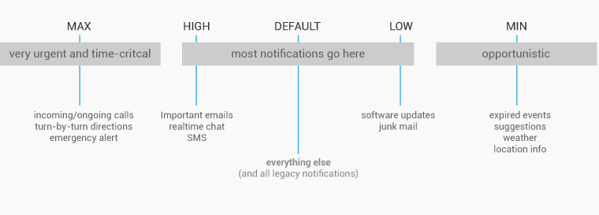
Notification Priority

Slide 64
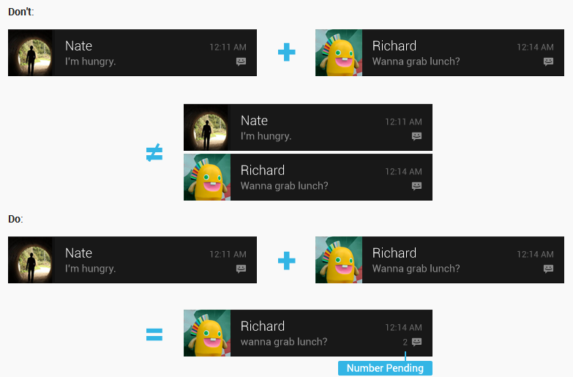
More Notification DOs
Stack notifications if app creates multiple notifications and user has not acted

Slide 65
More Notification Dos
Make them optional - PLEASE
use distinct icon
but not a different color
make LED glow based on priority

Slide 66
The Code of Notifications
Notification Object
Convenience NotificationBuilder
Must have at a minimum
small icon
title
detail text

Slide 67
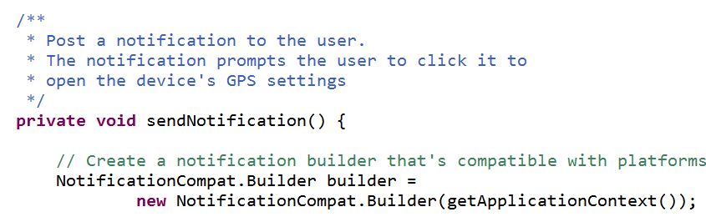
Simple Notification Building
Activity Recognition App
Send notification to turn on GPS

Slide 68
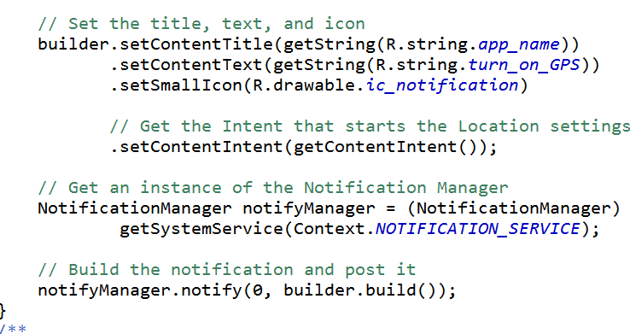
Simple Notification Building
Note setting title, text, and small icon

Slide 69
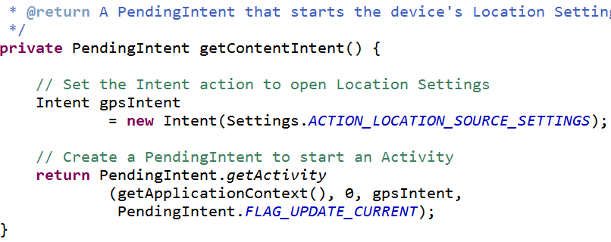
Notification Example
Includes Intent so user can turn on the GPS
Didn't just tell them to turn on GPS, make it easy for them to do so.

Slide 70
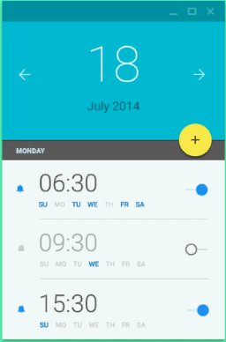
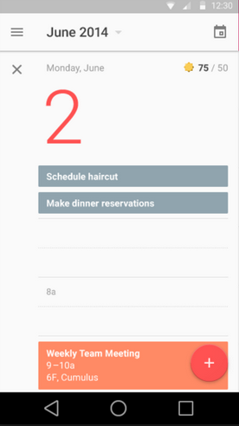
material design

Slide 71
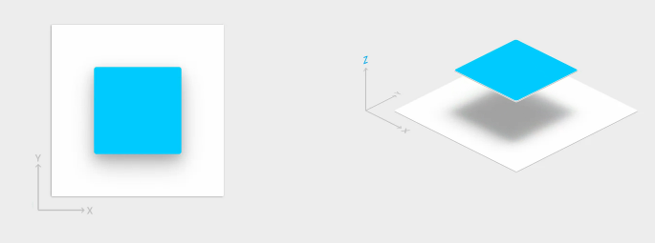
Material Design
Introduced in Lollipop, Fall 2014
Material design is a system and set of guidelines to help users understand the user interface and functionality of apps
"Took a step back" and build a design language based on classic design principles and real world materials, namely paper and ink.

Slide 72


Features of Material Design
Objects (visible widgets) in an app consist of paper and ink
paper can de different sizes, but preferred shapes are rectangles and rounded rectangles
all elements are 1 dpi thick
paper elements can be positioned next to and on top of each other in layers

Slide 73




Features of Material Design
Materials case shadows depending on their position
Guidelines on elevations for various components, affects amount of shadow

Slide 74


Component Elevation Guide

Slide 75
Motion in Material Design
Motion of interface elements used to convey meaning
Motion should be natural without abrupt starts and stops
User input from touch, voice, mouse, and keyboard (chrome on desktops)
Motion (animation) of user interface elements in response to user actions
surface reaction, material response, radial reaction

Slide 76

Surface Reaction
reaction of the ink to user input or action
vary animation based on point of input
Touch Ripple

Slide 77

Material Response
Material responds to being touched or activated by the user
indicates the paper component is made out of is active, being used
Move or transform form paper based on interaction
Move up when activated

Slide 78
Radial action
ink should respond like water when touched
ripples when touching a smooth surface of water

Slide 79
material design for developers

Slide 80
How to Implement App with Material Design
What tools are available to add material design features to our apps?
Android 5.0 / Lollipop / API level 21 added:
A new theme: material
new widgets
new view groups
new apis for custom shadows and animations

Slide 81
Material Theme
More complex than past themes such as theme and holo
Includes:
system widgets with option of picking color palette
built in touch feedback animations for those system widgets
activity transition animations

Slide 82

Using Material Theme

Slide 83
Creating Apps with Material Design
apply material theme to app
create layouts following material design guidelines
specify elevation of views to cast shadows
use system widgets for lists and cards
customize animations of app

Slide 84

Apply Material Theme
Specify in styles.xml that your app style is using Material Design

Slide 85
Create Lists and Cards
Android 5.0 / Lollipop / API level 21 added view groups to make apps based around material design possible
RecycleView
a more advanced and flexible version of ListView
inlcudes
layout managers for positioning items
built in animations

Slide 86

Create Layouts
When using material design your layouts have a elevation property
affects shadows created by widget

Slide 87
Widgets

Slide 88

Widgets
Referred to as an App Widget
widgets are miniature application views than can be added to other applications
normally the Home Screen View
other "App Widget Hosts"
Widget sent periodic updates
Widgets essentially a BroadcastRecevier with XML layout

Slide 89

Widgets
To create App Widget:
Create a AppWidgetProviderInfo
object that contains metadata for the App Widget, layout, update frequency
normally defined in XML
Implement AppWidgetProvider class that defines basic methods to update Widget
create layout: not all layouts and UI widgets supported

Slide 90
nfc - Near field communication

Slide 91
NFC
Another short range wireless technology
VERY short range: 4 cm or less to initiate a connection
Allows transmission of a small amount ("payload") of data between NFC tag or another Android device
NFC Tags offer read and write capability
More complex tags can perform mathematical ops, use encryption, and even have an operating enviroment

Slide 92
NFC Modes of Operation
Reader / Writer mode
allows NFC device to read and / or write passive NFC tags and stickers
P2P mode
allows NFC device to exhange data with other NFC peers
Used by Android Beam
Card emulation
allow NFC device to act as an NFC card

Slide 93

NFC Basics
Reading NDEF data from an NFC tag
NDEF: NFC Data Exchange Format
tag dispatch system: analyzes discovered tags, categories data, and starts applications (via intent filters) interested in data
tag dispatch system scanning for NFC tags if screen unlocked (unless turned off in settings)

Slide 94

Android Beam
Android Beam allows simple peer to peer data exchange between two Android powered devices
enable Android Beam for an app by calling:
setNdefPushMessage(), accepts a NdefMessage to beam
OR setNdefPushMessageCallback() create NDEF message when close enough to beam

Slide 95
bluetooth

Slide 96

wireless technology for exchanging data between devices over short distances
three different classes of Bluetooth devices with ranges of 1, 10, and 100 meters
Android devices provide access to the Bluetooth network stack

Slide 97
Android and Bluetooth
Android Bluetooth APIs
Android devices can:
Scan for other Bluetooth Devices
Check local Bluetooth adapter for paired devices
Connect to other Bluetooth devices
transfer data to and from connected devices

Slide 98


Bluetooth API
A few classes:

Slide 99
Android - Bluetooth Basics
Four major steps:
Setting up Bluetooth
permissions, BluetoothAdapter (like a manager), enable Bluetooth
finding paired or available devices
connecting devices
transferring data
http://developer.android.com/guide/topics/connectivity/bluetooth.html

Slide 100
copy and paste

Slide 101
Copy and Paste
clipboard based framework
simple and complex data types can be copied and pasted
text strings, complex data structures, text and binary stream data
Simple text stored on clipboard
complex data handled via content providers

Slide 102
Copy and Paste
to copy and paste:
data placed in clip object, clip object placed on system-wide clipboard
clip object can be:
text, a simple String
URI for copying complex data from a content provider
Intents to copy application shortcuts
only one clip on clipboard at a time

Slide 103
Copy and Paste
An app can support some or all of the data types
Examine data on clipboard and decide if user should have option to paste it
may not make sense to allow pasting of URI / content provider data or Intents

Slide 104
wi-fi Direct

Slide 105
Wi-Fi Direct
Added in ICS, Android 4.0 API level 14
allows devices with appropriate hardware to connect directly via Wi-Fi with no intermediate access point
discover and connect to other devices
much larger range than Bluetooth
Useful for applications that share data among users
multi player game, photo sharing

Slide 106
Wi-Fi Direct
WifiP2pManager class provides methods to discover, request, and connect to peers
Various Listeners that provide information on success or failure of method calls from WifiP2pManager
Intents notify application of events detected by Wi-Fi direct framework such as newly discovered peer
implement broadcast receiver for intents from Android system about Wifi Direct

Slide 107
3d graphics

Slide 108

2D Graphics
android.graphics library for 2D graphics (not Java AWT and Swing)
classes such as Canvas, Drawable, Bitmap, and others to create 2D graphics
Various attempts to make two d graphics appear more "lifelike" and 3 dimensional

Slide 109

Gradients
Gradient Paints can add depth to 2d primitives
Notice the gradient paint on the pegs and shading on numbers

Slide 110
2D Graphics

Slide 111

Wireframe Graphics
1979, Richard Garriott, Akalabeth
Ultima series, Ultima Online

Slide 112

Wireframe Vector Graphics
BattleZone - 1980

Slide 113

Parallax Scrolling Example

Slide 114

Parallax Scrolling
multiple backgrounds
backgrounds closer to view move at a faster speed than backgrounds farther away

Slide 115


2.5D
Isometric Graphics
"rotate" object to reveal details on the side
Zaxxon
Ultima Online

Slide 116
3D Graphics
Create 3D model
a small scene or a large world
Model rendered into a 2D projection
model includes
objects (boxes, cones, cylinders, sphere, user defined models)
lighting
cameras
textures
dynamic behaviors

Slide 117
3D Coordinate System
x and y as expected (positive y is up, not down as in 2d graphics
z axis - positive z is out of screen, negative z is into screen
y⁺
z⁻
z⁺
x⁺

Slide 118


Visual Portion
Portion of 3D Scene that is rendered is contained in a frustum (pro: frəstəm)
a pyramid or cone with its top cut off
objects in scene, but not
visible

Slide 119



OpenGL
Developed by Silicon Graphics Inc.
developer of high end graphics systems and machines in 80s and 90s
Integrated Raster Imaging System Graphics Library
1992 OpenGL
maintained by non profit Khronos Group

Slide 120
OpenGL
low level, procedural API
programmer responsible for defining steps to create and render (show) a scene
alternatives use a scene graph where programmer describes scene and actions (behaviors) and library manages the details of rendering it
Example of Graphics libraries that use Scene Graphs: Java3D, Acrobat 3D, AutoCAD, CorelDRAW, RenderMan (Pixar)

Slide 121
OpenGL ES
ES = Embedded Systems
Used in a wide variety of devices, not just Android
iPad, iPhone, Blackberry, symbian, Nintendo3DS, Playstation 3, Web GL
OpenGL version ES 2.0 API supported in Android 2.2 and higher (API levels 8 and higher)
prior versions of Android support ES 1.1
emulator DOES NOT support ES 2.0

Slide 122
Android and OpenGL ES
two ways of working with GL:
through the framework APIandroid.opengl package
via the Android Native Development Kit (NDK)
companion tool to Android SDK to build portions of apps in native code in C or C++
Required Android classes for first approach:
GLSurfaceView and GLSurfaceView.Renderer

Slide 123
GLSurfaceView
Similar to SurfaceView
draw and manipulate objects using Open GL API calls
to respond to touch screen events subclass GLSurfaceView and implement touch listeners

Slide 124
GLSurfaceView.Renderer
An interface
Must implement these methods:
onSurfaceCreated for actions that only happen once such as initializing GL graphics objects
onDrawFrame() work horse method to create movement and animation
onSurfacechanged() called when size of view changes or orientation

Slide 125
Manifest Requirements
To use OpenGL ES 2.0 (Android 2.0 and later)
if app uses texture compression formats must declare which formats application supports
<support-gl-texture>

Slide 126
Steps to Use OpenGL
Create activity using GLSurfaceView and GLSurfaceView.Renderer
Create and draw graphics objects
define projection for screen geometry to correct for non square pixels
define a camera view
perform actions to animate objects
make view touch interactive if desired

Slide 127
Sample Program
Demonstrate set up of required elements
draw and rotate a 3d object (a pyramid)
Create Simple Activity that has a GLSurfaceView as its content view
To draw objects must implement GLSurfaceView.Renderer

Slide 128

Activity

Slide 129

GLSurfaceView
Shell of class
Used to manage surface (special piece of memory), manage EGL display (embedded graphics library, renders on thread decoupled from I thread, and more

Slide 130

Skeleton Renderer

Slide 131
OpenGL Documentation
Android Documentation for GL10 list constants and methods but have no other useful information
Check the OpenGL ES documentation
http://www.khronos.org/opengles/sdk/1.1/docs/man/

Slide 132
Low Level Graphics Libraries
"What makes the situation worse is that the highest level CS course I've ever taken is cs4, and quotes from the graphics group startup readme like 'these paths are abstracted as being the result of a topological sort on the graph of ordering dependencies for the entries' make me lose consciousness in my chair and bleed from the nose." -mgrimes, Graphics problem report 134

Slide 133
Draw a Shape
Draw a simple, flat Triangle using OpenGL
(X,Y,Z) coordinate system
(0, 0, 0) center of frame
(1, 1, 0) is top right corner of frame
(-1, -1, 0) is bottom left corner of frame
must define vertices of our triangle

Slide 134

Define Triangle
-1 0 1
1 0 -1

Slide 135

Draw Triangle
init OpenGL to use vertex arrays
call drawing API to draw triangle

Slide 136

Result
oooo, ahhhh
Graphics coordinate system assumes a square but mapped to a rectangular frame

Slide 137
Correcting Projection
Apply an OpenGL projection view and camera (eye point) to transform coordinates of the triangle
"correct" the position onSurfaceChanged and onDrawframe()

Slide 138

onSurfaceChanged

Slide 139

onDrawFrame

Slide 140


Result of Correcting Projection

Slide 141

Adding Motion
in onDrawFrame
define vector of rotation

Slide 142


Results
X Axis (angle, 1, 0, 0) Y Axis (angle, 0, 1, 0)

Slide 143


Results
Z Axis (angle, 0, 0, 1) Y Axis (angle, -1, 1, -1)

Slide 144
Another Example
Draw a pyramid that bounces around the screen
Same basic steps as previous apps
Activity with GLSurfaceView
Implementation of GLSurfaceView.Renderer
Pyramid class that defines the geometry and appearance of 3d pyramid object

Slide 145

Constructing Pyramid
specify vertices for 6 triangles
4 sides, 2 triangles for the base
1 (-1, 1, -1)
2 (1, 1, -1)
4 (0, 0, 1) imagine it out of screen
0 (-1, -1, -1)
3 (1, -1, -1)

Slide 146

Constructing Pyramid
Indices refers to set or coordinate (x, y, z)

Slide 147

Coloring Pyramid
Define colors for each of the 5 vertices
Colors blend from one vertex to another
recall, rgba

Slide 148

Result

Slide 149
OpenGL Options
Renderscript
high performance, but low level
scripts written in C
OpenGLUT, OpenGL Utility Toolkit
not officially part of Android, Android GLUT Wrapper
include more geometric primitives

Slide 150
RenderScript

Slide 151
RenderScript
Component of Android OS
Purpose: run computationally intensive tasks at high performance
data-parallel computation
RandomArt!
Use RenderScript to parallelize work across all processors on a device
multi core CPUs

Slide 152

RenderScript
Write a "RenderScript kernel" in "C99 like" language
ISO/IEC 9899:1999 version of C
scripts contains sub kernels, functions, and variables

Slide 153
RenderScript
Plus a Java API to interact with the scripts and control execution
conduit between your application code and the RenderScript

